Slide 1
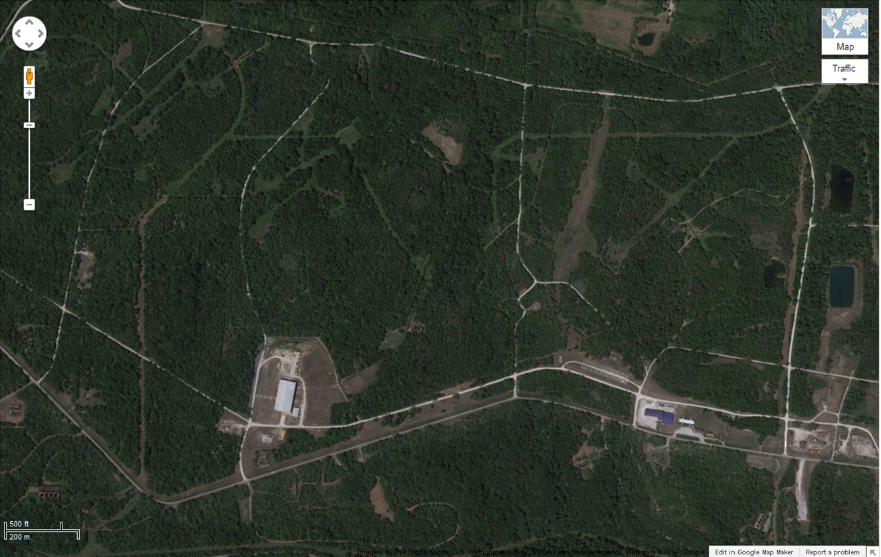
Weldon Springs Map with Checkpoints
West Boundary No vehicles past this point
18
13
12
Packhouse Rd.
4
North Howell Rd.
Pitmans Rd.
fAusburn Rd.
Obstacle Course
11
Ordnance Rd.
17
5
3
Landing Strip Rd
Ware House.
10
6
16
Tank Trail Rd.
7
9
14
8
2
Route A
Cantonment
Area
1
15

